Slide 1

Where digital transformation is not a destination, but a continuous journey of innovation and progress.
Empowering service excellence through intuitive, code-free customization

Slide 2
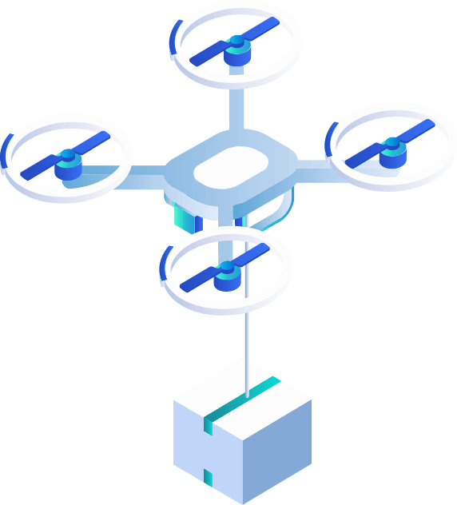



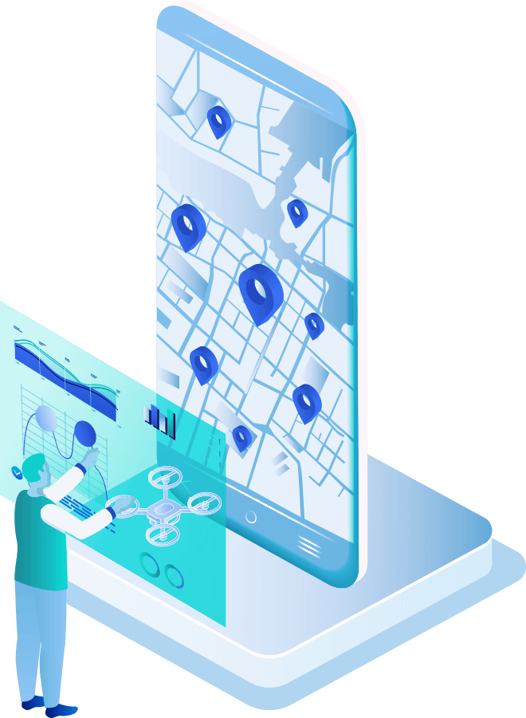
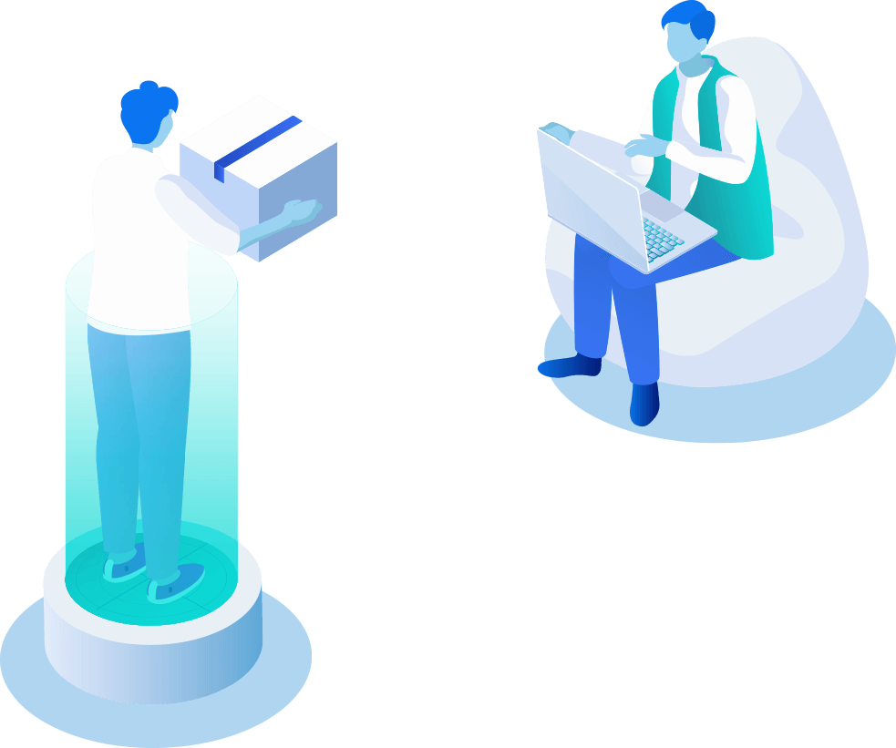

Introduction
ServicePlus provides a comprehensive platform tailored for modernizing service delivery in governmental agencies. It empowers users to design and customize services according to their specific requirements. Through intuitive configuration tools, users can craft solutions without the need for any coding, ensuring flexibility and adaptability.

Slide 3
Online Services offered through ServicePlus

Slide 4
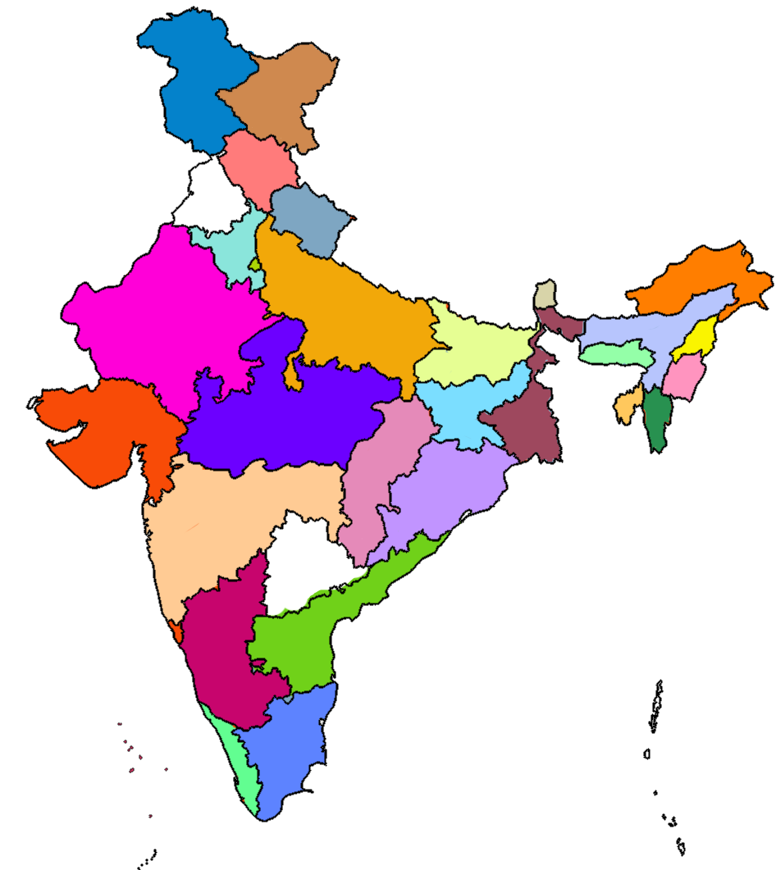
Implementation Status
Entities Using ServicePlus Under different Brand Names
States/UTs | 36
Central Departments | 18
Statistics
No. of Services | 3564
Applications Received | 345 Million
Revenue Collected | 33.6 Billion
DBT Disbursement | 5.8 Billion
Category of Services
2537
2393
Type of Services
931
498
453
Govt. To Employee (G2E)
Govt. To Citizen (G2C)
Developmental
Regulatory
Govt. To Business (G2B)
Consumer Utility
Govt. To Govt. (G2G)
Statutory
79
17
220
Services
Services

Slide 5

ServicePlus – Journey at a Glance
Pattern Generation, Punjab & WB eTreasury, Grievance Module, Audio Captcha, Secured API’s, Login preference, Configurable Ref. No., TejasVI, Unique URL for Report
DigiLocker, RAS, eTreasury, Mobile App, DigitalSign, CSC Wallet, Notification Designer, Sync/async Webservice, Aadhar, PayU, Service Versioning (Major & Minor), eKYC, Configurable login Module
Incorporation of Configurable features gathered through Regional Workshop
Form Design & Document Design.
GUI Based Workflow Configuration, WhatsApp, ICICI EazyPay, BHASHINI and more
Aadhaar 2.5, Mobile App Integration, DigiLocker 360, PFMS, DBT, JanParichay, Sandes, BharatKosh
Payment Gateways. Action Forms, Derived Services, Business Rule Injection, Merging & Forking of applications, FIFO, Bulk Processing, JS insertion, Velocity Template, MVEL, Action Call-back
2022-23
2016-18
2024-
2019-21
2010-11
2013-15
Growing adoption of ServicePlus by states and departments has been paralleled by technical evolution of the platform

Slide 6
Why ServicePlus
Configurable Unified Platform
A unified platform throughout every stage of the service lifecycle.
Facilitates Rapid Rollout
Government entities can offer services promptly, around the clock.
ServicePlus
A Metadata Based eService Delivery Framework.
Low code/No code platform
Robust features to design, configure and efficiently execute service delivery
Robust Security
advanced security measures, including SSL/TLS encryption and OAuth 2.0 authentication

Slide 7
ServicePlus
Common platform for actors with varying needs
Service Owner
Applicant
Workflow Player
Configure services using a wizard-style interface.
Establish comprehensive grievance redressal policies for each service.
Launch new services in a matter of minutes.
Submit applications by self or via Assisted Mode
Track application status online
Receive status alerts for submitted applications
Lodge grievances for service deficiencies or failures
Role-Based Access Control (RBAC)
Customizable Workflows
Monitoring and Management Dashboard
Automated Notification System
1
2
3

Slide 8





Form Designer
Design and customize dynamic forms effortlessly
Notification Designer
Design and automate customized notifications for seamless communication
Critical Components of ServicePlus
Process flow Designer
Streamline and automate the workflows
Document Designer
Design, customize, and generate documents
External System Integration
Seamless Integration through API
Mobile Enablement
integrate Services with mobile apps for enhanced accessibility

Slide 9
ServicePlus : Offers excellent Form Builder tool to design multi-lingual forms through drag & drop
Form Designer
1
Design customizable forms for applicants and officials with multi-page support.
Include built-in and server-side validation for fields, with API-based data validation.
2
Special fields with predefined functionalities and allow user-defined JavaScript insertion.
Link fields across forms and ensure data collection using predefined formats.
4
3
Provide help-text at both form and field levels to assist users.
5

Slide 10



Notification Designer
Notifications via SMS, Email, Sandes and WhatsApp.
Smart Selection of Phone and Email Contacts
User-defined notification content and trigger points.
Tailored notifications on Trigger points Accept, Reject, Process etc
OTP based verification of Mobile/Email
Dedicated module for bulk notifications
ServicePlus : allows crafting personalized notifications for seamless user experiences

Slide 11







Process flow Designer
A
Intuitive Drag-and-Drop Interface
Easily design and manage workflows with a user-friendly drag-and-drop interface.
Customizable Workflows
B
C
Tailor workflows to meet specific requirements and streamline processes.
Conditional Logic Integration
D
Implement conditional logic to automate decision-making and optimize workflow efficiency.
Diverse Task Types
E
Include various task types such as Timer Tasks and Webservice Tasks to cater to different process needs.
F
Forking and Merging Using Gateways
Real-Time Workflow Monitoring
G
Utilize gateways to fork and merge processes, enabling complex workflow structures.
Track and monitor workflows in real-time to ensure smooth operation and quick issue resolution.

Slide 12
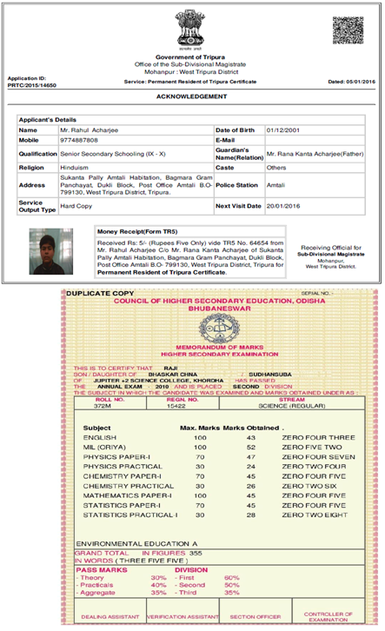


Document Designer
01
Create custom documents and certificates using the integrated editor.
Supports generation of various formats: HTML, XML, Spreadsheet, PDF, etc.
04
02
Apply data-based conditions; Include QR Codes, DSC Stamps, and Water Marks
05
Attach Form Values and System Variables to documents.
03
06
Design Acknowledgement, Delivery, Rejection, or Intermediate certificates.
Generate a unique URL for each certificate upon Delivery, Rejection, or task action.
ServicePlus :Allows crafting dynamic and personalized documents - empowering service delivery excellence

Slide 13





Seamless Integration
01
with Aadhaar, eSign, PFMS, eTaal, DigiLocker, and more.
Integration with External Systems
Payment Gateways
02
BharatKosh,SBI ePay, PayU, BillDesk, ICICI, CSC eWallet, & more
03
Direct Benefit Transfer
DBT payments through PFMS integration.
04
RESTful API
configurable interface for integrating with any RESTful API.
Data Sharing
05
through configurable API; synchronous & asynchronous
Unlock seamless connections with ServicePlus - where integration meets innovation

Slide 14
Mobile Enablement
Responsive
Generate responsive forms compatible with all devices for a seamless user experience.
Mobile App
Provide a versatile mobile app tailored for personalized user experiences.
Service Launch
Roll out services dynamically on mobile devices for enhanced accessibility and convenience.
Services on Other Apps
Integrate securely with mobile apps via APIs to expand functionality and connectivity.
Real-time Access
Enable real-time access to services on the go, optimizing performance and user engagement.
ServicePlus offers a customizable mobile app to adapt to evolving needs seamlessly.

Slide 15
Grievance Redressal
Redressal
ServicePlus platform includes comprehensive grievance redressal capabilities
Compliance
Administrators can define grievance policies in line with service delivery acts.
Tiered
Supports up to three levels of appellate authorities (First, Second, and Third).
Escalation
Automates escalation and routing of grievances based on predefined rules.
Grievance Tracking
Provides detailed tracking, monitoring, and configurable notifications for grievance status updates.
Insight
Comprehensive dashboard for identifying pain points and improving processes, for transparency and accountability.
Empowering citizens with ServicePlus: Where grievances meet resolutions for seamless service delivery

Slide 16

Reports
SPReport module to generate service-specific analytical and monitoring reports for insights into service delivery.
Customize report templates and filters to meet the unique needs of different departments and services.
Interactive dashboards and visualizations for clear data presentation and data-driven decision-making.
Integrate with external data sources to provide a consolidated view of service delivery performance, with role-based access controls and export options in various formats.
SPReport - where data meets clarity for informed decisions

Slide 17






ORGANISATION STRUCTURE
Facility to hold complete structure of any Department/Organisation
HIERARCHY
Facility to define the hierarchical
setup of any Department/Organisation
Capturing Hierarchies and Structure of Government
offices & Entities
DESIGNATIONS
Captures designations exist in any department or organisation
INTER-DEPARTMENTAL MAPPINGS
Mapping between departments based on area of jurisdiction
CONSTITUENCY DATA
Electoral Constituency Structure and Mapping with departments

Slide 18
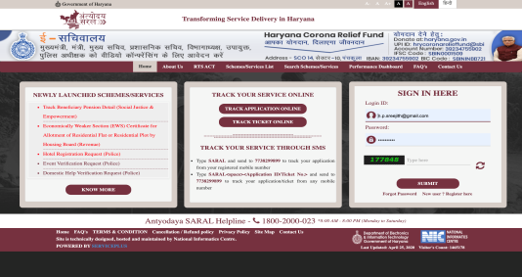
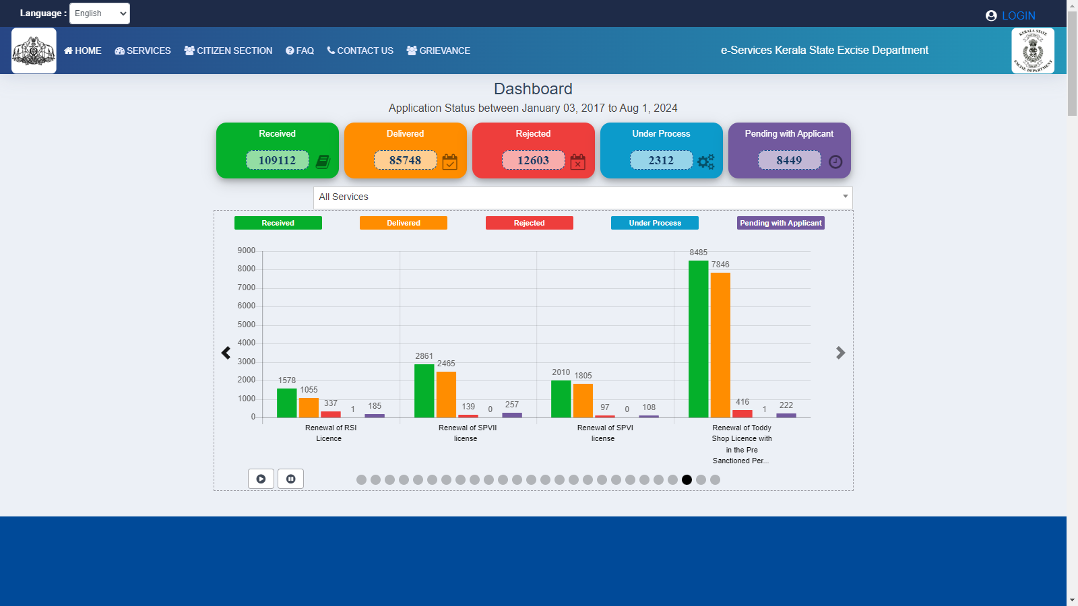
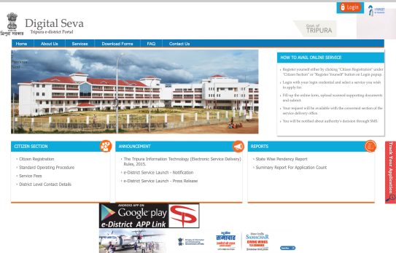
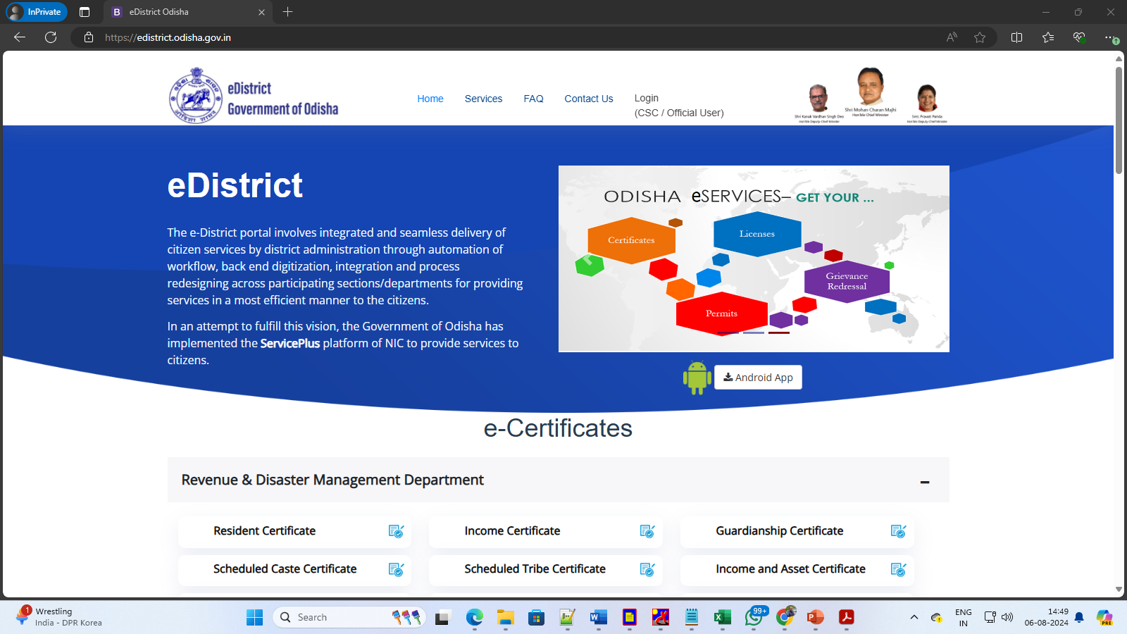
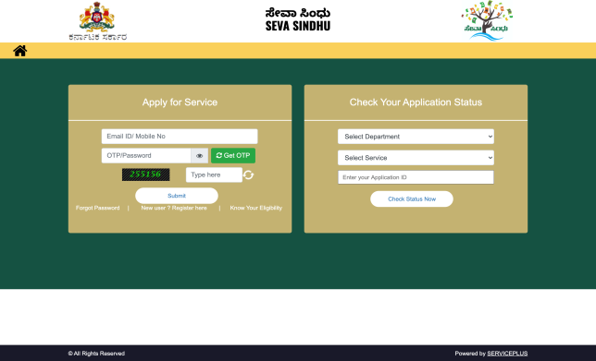
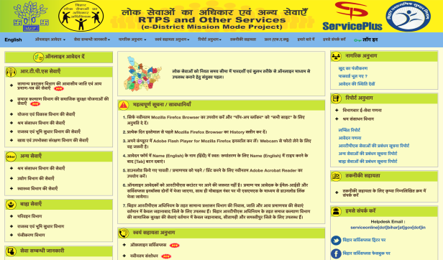
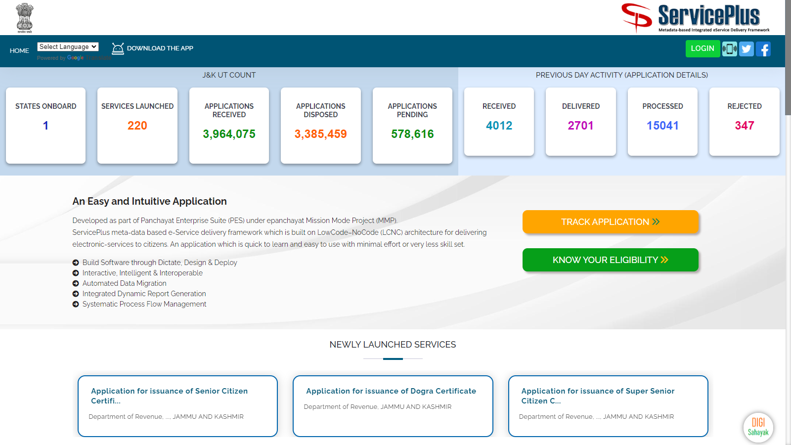
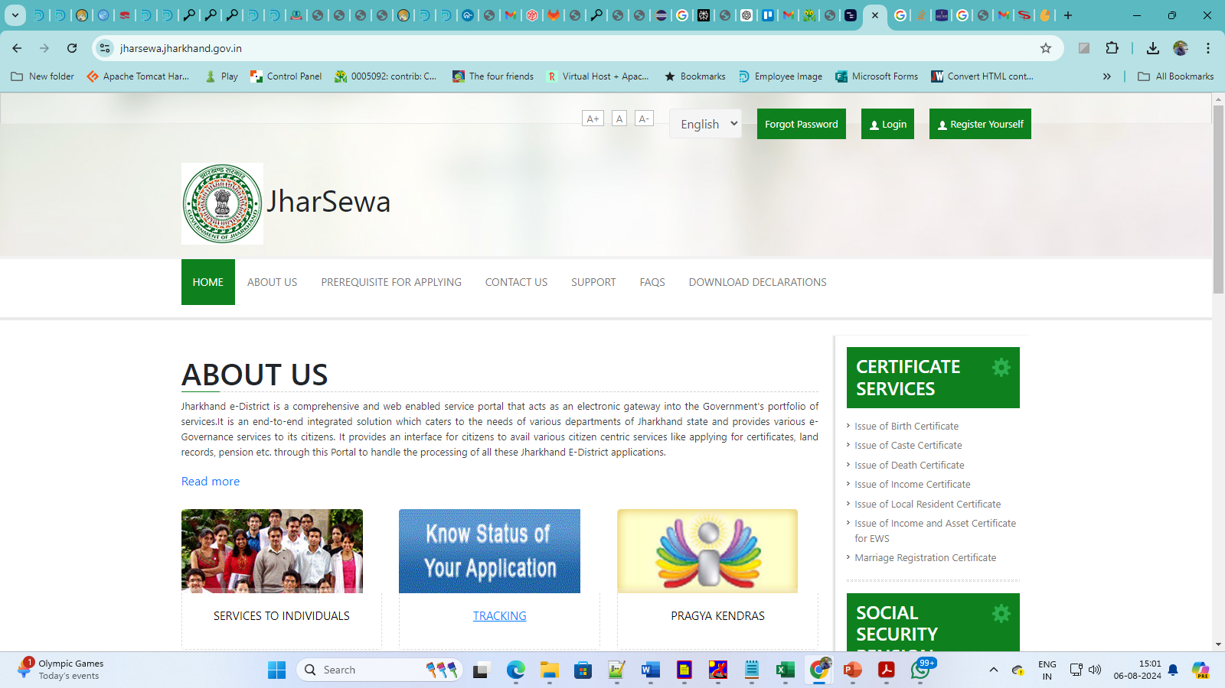
ServicePlus can be configured to generate separate pages and/or URL
Saral Haryana
Excise Dept. Kerala
eDistrict Tripura
eDistrict Odisha
URL For
Each Service,
A Department
Entire State
SevaSindhu
Karnataka
RTPS
Bihar
JanSugam
Jammu&Kashmir
JharSewa
Jharkhand

Slide 19

Service Definition Lifecycle
01
Fill-in the Service Definer Guide
Configure
Service
Implement
Tenancy Extn
02
Freeze the Service
Assign Users
Activate Service Units
03
Test the Service
Train the Officials
Launch the Service
ServicePlus ensures a holistic service experience through meticulous definition, management, access, support, and delivery across the entire service lifecycle.

Slide 20
Focus Areas
Agility
Rapidly roll out services at any level by any government entity, anytime.
Unified Framework
A configurable, unified framework for service delivery & grievance redressal.
Tools
Powerful in-built tools for designing, configuring, and executing services.
Unified
Single platform for the entire service lifecycle.
Multi-Tenancy
Support multi-tenant architecture.

Slide 21
Future Plans
Sept 2024
Bhashini, Data Discovery through Elastic Search & Rabbit MQ Implementation
April 2025
To bring modularity using Micro Services Architecture
.
May 2026
Extending the functionalities to generate Web-App through ServicePlus
Nov 2024
Upgraded SPReport Module handling Live Data
July 2025
Shifting from virtual machines to Docker containers.

Slide 22




Thank You
Address
eService Delivery and Transformation Division
A3B4, III Floor,
National Informatics Centre
A-Block, CGO Complex,
New Delhi, INDIA 110 003
Contact Numbers
+91-11 - 24305353
Email Address
support.serviceplus@nic.in

